Slide 1
Health Savings Accounts
Pub 4012 – Tab E
Pubs 969 and 4942
Form 8889 Instructions
Notes:
HSA is an optional certification
Some awareness is needed for Counselors to identify when a taxpayer has an HSA

Slide 2
IRS Certification
Pub 4942
2018 Course and Test
VITA/TCE Counselors must pass Health Savings Account (HSA) test to certify
States may not conform
Check state for scope
Notes:
HSA certification required
Course and test are in Pub 4942

Slide 3
HSA Benefits
Contributions are potential tax deduction
Employer contribution excluded from taxable W-2 wages
Contributions accumulate tax free until distributed
Notes:
Employer contributions cannot be used as an adjustment to income.
Employer contributions (W-2, box 12, code W) includes contributions made through a Section 125 cafeteria plan.

Slide 4
HSA Benefits
Distributions nontaxable with paid unreimbursed qualified medical expenses
HSA remains with the taxpayer
“Portable” with job change or retirement
Contributions remain in account until used
Notes:
HSA stays with taxpayers even if they change employers or leave the work force.

Slide 5
HSA Defined
HSA is tax-exempt trust or custodial account set up with qualified HSA trustee
Must be eligible individual
Limited tax deductible contributions

Slide 6
HSA Eligibility Requirements
Must be covered under high deductible health plan (HDHP) for self or family
Insurer identifies qualified plans
Cannot be covered by other health insurance
Exceptions next slide
Spouse eligible for other coverage if not HSA owner
Eligible individual cannot be a dependent of another taxpayer
Notes:
Exceptions to other health insurance. Other permissible health coverage on next slide

Slide 7
Permissible Health Coverage with HSA
Pub 4942 or 969
Insurances allowed with HSA
Disability
Dental
Vision
Accident
Long-term care
Limited flexible spending account
Notes:
Exceptions to other health coverage:
Workers comp
Coverage re tort or use of property liabilities
Specific disease / illness policies
Fixed per-period hospitalization coverage
Accident coverage
Disability
Dental or vision
Long-term care
Re prescriptions – see pub 969

Slide 8
HSA Set up
HSA can be set up by
Eligible individual
Eligible individual through employer plan

Slide 9
HSA Trust
Pub 969
HSA trust must be with authorized HSA trustee
No provision for jointly owned HSA
When HSA holder dies and
Beneficiary is surviving spouse
Treated as spouse’s
Beneficiary other than surviving spouse
Accounts stops being HSA – out of scope

Slide 10
Contributions to HSA
Contributions can be made by
Eligible individual
Employer
Any other individual
Treated as gift
Deductible by the taxpayer
Contributions must be cash
No stock or property
Notes:
For example, grandparent may contribute to parent’s HSA; parent determines deduction

Slide 11
Employer HSA Contributions
Employer can set up HSA for employee with authorized trustee
HSA must be set up before end of year
Taxpayer must have HDHP coverage during the year
Contribution not taxable wages to employee
Notes:
Special rules apply if employer contribute in excess of permitted amount – See Form 8889 instructions
HDHP – High deductible health plan

Slide 12
Individual HSA Contribution
Qualified HSA contributions by individuals are deductible
No income or compensation requirement
As for IRA

Slide 13
HSA Contribution Limit
Contribution limits depend on
Type of HDHP coverage
Self or family
Date taxpayer became eligible individual
Date taxpayer ceased being eligible individual
Taxpayer’s age

Slide 14
HSA Contribution Limit
2018 HSA contribution limit
$3,450 for self-only HDHP
$6,900 for family HDHP
Additional $1,000 if age 55 or older
Reduced by employer contributions
Notes:
Special rules apply for the year the HSA is set up.

Slide 15
Example 1: HSA Deduction
Carla is an eligible individual
Had self-only HDHP coverage for entire year
Had HSA for entire year
Age 38
She can contribute and deduct up to $3,450

Slide 16
Example 2: HSA Deduction
Same as Example 1, add that:
Carla’s employer contributes $900 to Carla’s HSA
Reported on W-2 Box 12 code W
She can contribute and deduct up to $2,550
($3,450 maximum contribution - $900 W-2 contribution)

Slide 17
Partial Year HSA Eligibility
Form 8889 Instructions
Monthly eligibility determined on first day of each month
A taxpayer who is not HSA eligible the entire year
Contribution limited to greater of
Limitation chart and worksheet
Maximum contribution based on first day of last month of tax year (last-month rule)
Notes:
If HSA eligible December 1, 2018, eligible to contribute maximum $3,450 self or $6,900 family regardless of other months eligibility.
Limitation chart and worksheet located in form 8889 instructions

Slide 18
HSA Contribution Last-Month Rule
Eligible individual can make full year contribution if
Eligible individual on first day of last month of tax year
Generally December 1
And remain eligible individual during 12 month testing period
From December 1 of the current year through December 31 of the following year

Slide 19
Example 3: HSA Deduction
Maria, age 48:
Eligible individual with self-only HDHP coverage from January through August
Not an eligible individual from September through December
Use the limitation chart and worksheet in Form 8889 Instructions to calculate her maximum contribution

Slide 20
Example 3: HSA Deduction, cont.
January | 3,450
February | 3,450
March | 3,450
April | 3,450
May | 3,450
June | 3,450
July | 3,450
August | 3,450
September | 0
October | 0
November | 0
December | 0
Total for all months | 27,600
Limitation. Divide the total by 12 | 2,300
Maria will enter $3,450 for
Jan – Aug; $0 for Sept – Dec
Deduction limited to greater
of $0 (Dec deduction) or $2,300
($27,600 [8 X $3450] ÷ 12)
Notes:
Deduction is limited to greater of $0 – Maximum contribution based on last-month of tax year OR $2,300 - limitation worksheet

Slide 21
Example 4: Last-Month Rule
On December 1, 2018:
Chris, age 53, is eligible individual for HSA
Started family HDHP coverage
Expects to meet the testing period requirement by remaining eligible through December 31 of the following tax year
Under the last-month rule, he can contribute up to $6,900, the maximum family contribution limit for 2018

Slide 22
Example 5: Testing Period
Testing period not met:
Assume Chris from Example 4 is not an eligible individual starting June 2019
He must recalculate his 2018 allowable contribution and include the excess contribution in his 2019 income (subject to additional 10% tax)
He’s entitled to 1/12 of $6,900 or $575 (Dec 2018)
$6,325 taxable income in 2019 ($6,900 - $575)
Note that Chris’ 2019 return is out of scope

Slide 23
HSA Rules for Married Taxpayers
When both spouses are HSA eligible and
Each has self-only HDHP coverage
Each can contribute $3,450
Total contribution/deduction = $6,900 (self only limit $3,450 X 2)
Additional contribution
55 or older can contribute additional $1,000

Slide 24
HSA Rules for Married Taxpayers
Either spouse has family HDHP coverage, both spouses treated as having family HDHP coverage
Family contribution limit applies $6,900
Split evenly unless agree upon different split
Max contribution and deduction = $6,900
Additional contribution
55 or older can contribute additional $1,000
Notes:
Rules for married couple apply only if both are eligible individuals
Spouses can split the allowable family amount ($6,900) as they agree. If don’t agree, evenly.
The additional $1,000 must be to the HSA of the person who is 55 or older

Slide 25
Example 6: Married Taxpayer
Pub 4012 Tab E
Mr. and Mrs. Auburn are eligible individuals
Mr. Auburn is 58 years old, Mrs. Auburn is 53
Both have HDHP family coverage and an HSA
They may split the family ($6,900) contribution limit equally or may agree on a different division
Mr. Auburn can contribute an additional $1,000 to his HSA because he is age 55 or over
Notes:
‘How to enter into TaxSlayer’ slides to follow
Pub 4012 Tab E Chart #4

Slide 26
Excess HSA Contribution
Do not claim deduction for excess contribution
Withdraw excess contribution by due date of return
Withdraw and include on return
Earnings on the excess
e.g. Interest
Earnings reported as other income form 1040
Notes:
Due date of return includes extensions

Slide 27
Excess HSA Contributions
Form 5329 Part VII
Excess contributions incur additional 6% tax until
Withdrawn or
Used as qualified contribution in later year
Out of scope if additional tax applies

Slide 28
HSA Contribution Deadline
HSA contributions can be made up to due date of return
Without regard to extensions
Notes:
HSA contribution Apr deadline

Slide 29
HSA Distributions
Distributions not taxed if used to pay or reimburse qualified medical expenses
Expense must be incurred after HSA set up
Even if the last-month rule is used
No time limit to take distribution
Do not deduct medical expense on Schedule A if expenses will be reimbursed by HSA
If reimburse medical that was previously deducted, treat as a recovery (tax benefit rule applies to see if it is taxable)
Notes:
Funds can stay in HSA for years

Slide 30
Excess HSA Distribution
Excess distribution included as taxable income
Form 8889 entry
Other income Form 1040
Subject to 20% addition to tax
Exceptions
Death
Disability
After age 65
Notes:
Out of Scope: Deemed distributions from an HSA due to prohibited transactions, such as using an HSA as a security for a loan

Slide 31
Nonqualified HSA Distributions
Form 1099-SA Instructions
Taxpayer can repay nonqualified distribution
no later than April 15 following first year account beneficiary knew/should have known distribution in error
Notes:
Example
Laura established an HSA in July. She incurred medical expenses in May and wants to pay those from her HSA. The expenses incurred in May before she established her HSA are not qualified medical expenses for purposes of her HSA.
Example
Vikki’s doctor suggested she take some exercise classes. Vikki signed up for yoga, swimming classes, and a health club. Since these are for general health improvement, they cannot be considered as qualified medical expenses.
TIP: Preventive services, not reimbursed by the HDHP, can be paid from an HSA.
April 15 is a set date. It is not the due date of the return.

Slide 32
Qualified Medical Expenses
Pub 502 Medical and Dental Expenses
Qualified medical expenses include
Medical and dental expenses that would qualify as itemized deduction
Doctors, dentists, and hospitals
Medicine or drug if
Requires prescription
Prescription for over-the-counter medicine
Insulin

Slide 33
Qualified Medical Insurance Expense
Pub 969
Insurance premiums that are qualified medical expenses
Long-term care coverage
COBRA
Coverage while receiving unemployment
Medicare or other coverage if over 65
Not supplemental coverage, e.g. medigap
Notes:
See Publication 502, Medical and Dental Expenses, for more information

Slide 34
Qualifying Expense for Family members
Qualifying expenses incurred by
Taxpayer and spouse
Dependents claimed on return
Others who could have been claimed as a dependent except that
Person filed a joint return or
Person failed gross income test or
Taxpayer or spouse could be claimed as a dependent on another’s return
Notes:
Caution: Taxpayers cannot deduct qualified medical expenses as an itemized deduction on Form 1040, Schedule A, that are equal to the tax-free distribution from their HSA. Since the medical expenses have been paid from HSA funds, the taxpayers cannot include the same expenses on Schedule A.
TIP: A child of parents who are divorced, separated, or living apart for the last six months of the calendar year is treated as the dependent of both parents (for medical expenses) whether or not the custodial parent releases the claim to the child’s exemption.
TIP: Even taxpayers who have a self-only HDHP may use the money in their HSA to pay the unreimbursed medical expenses for their spouse or other family members (as described previously).

Slide 35
HSA Rollovers or Transfers
Pub 969
HSA rollover and transfer rules similar to IRA
Trustee-to-trustee transfers nontaxable and not considered rollover
Only one rollover allowed during 12-month period
Must be completed within 60 days
Rollover and transfers not subject to contribution limits
Notes:
TIP: If the taxpayers have their HSA funds transferred directly into another HSA in a trustee-to-trustee transfer, this is not considered a rollover. There is no limit on the number of these transfers. Do not include the amount transferred in income, deduct it as a contribution or include it as a distribution on Form 8889.
See Publication 969 for more information
Rollover contribution: Tax-free distribution to the taxpayer from one HSA where the taxpayer contributes to another HSA
Not included in taxpayers’ income
Not deductible
Not subject to taxpayers’ contribution limit
Must roll over the amount within 60 days
May only make one rollover contribution to an HSA during a one-year period
Archer MSAs are out of scope

Slide 36
HSA Recordkeeping
HSA recordkeeping is taxpayer’s responsibility
Maintain receipts to support qualified distributions
Notes:
Taxpayers who have taken HSA distributions will receive Form 1099-SA from their HSA trustee
For recordkeeping requirements on HSA distributions see Publication 969

Slide 37
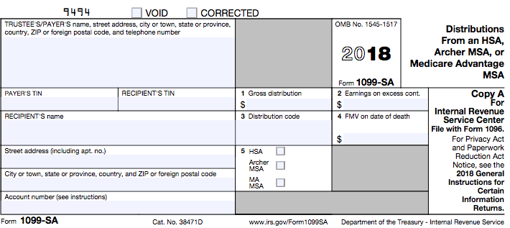
Form 1099-SA Distributions
Notes:
Instructions: Box 3. These codes identify the distribution you received: 1—Normal distribution; 2—Excess contributions; 3—Disability; 4—Death distribution other than code 6; 5—Prohibited transaction; 6—Death distribution after year of death to a nonspouse beneficiary

Slide 38
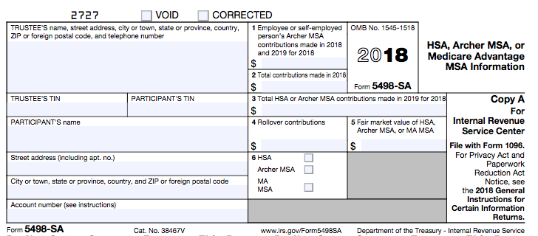
Form 5498-SA Contributions
Notes:
TIP: Form 5498-SA is issued by the HSA Trustee showing the amount of HSA contributions.
Caution: Taxpayers may not receive Form 5498-SA before the filing deadline, but they should have the information regarding contributions to their HSA.
Form generally received in May

Slide 39
Form 8889
Form 8889 Instructions
If taxpayer and spouse both have HSA
File separate Form 8889 for each
If one has family coverage
Use Family for both
Split allowable contribution between taxpayer and spouse Line 6 Form 8889
Notes:
Special rules apply for the year the HSA is set up.

Slide 40
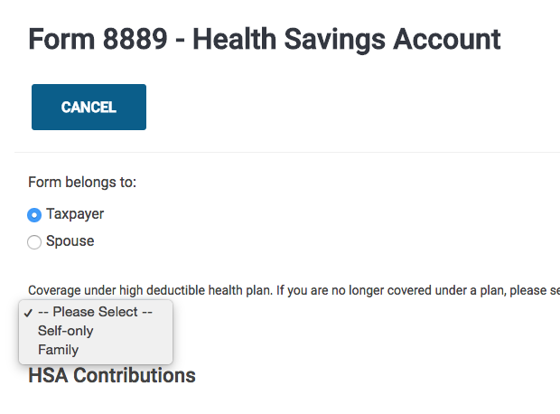
TaxSlayer Form 8889 Input
Indicate owner
Indicate type of plan

Slide 41
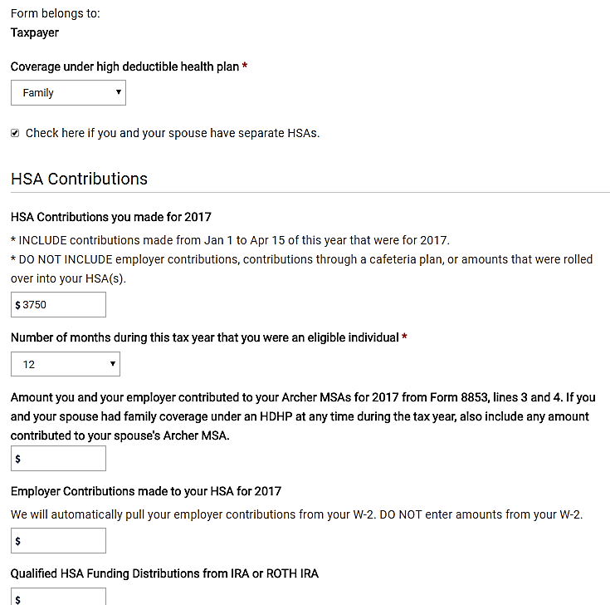
TaxSlayer Form 8889 Input
NTTC-Modified Pub 4012 Tab E
If one spouse has family coverage, both considered to have family coverage
Form 8889 – Health Savings Account
Self-only or Family
When the box is checked, manually complete the HSA Adjustment Section
Check box when both spouses have HSAs and one spouse has family coverage
Notes:
If one spouse has family HSA coverage, both spouses are considered to have family coverage. Enter ‘Family’ for both taxpayer and spouse for type of coverage. When both taxpayer and spouse have separate HSAs, check the box. You MUST complete the adjustment section when the box is checked. Checking the box takes all calculations off line 3 and 6 of form 8889.

Slide 42
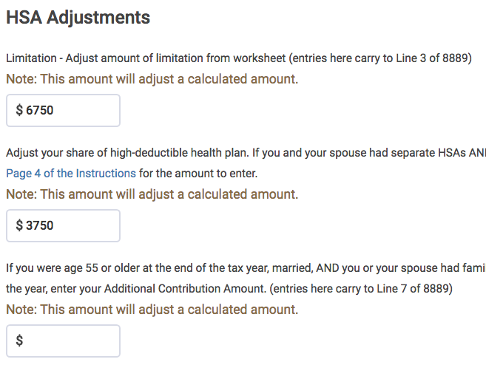
TaxSlayer Form 8889 HSA Adjustment
NTTC-Modified Pub 4012 Tab E
If box is checked, ‘Check here if you and your spouse have separate HSAs’: enter HSA contribution limitation – $6,900 for 2018 if full year eligible or last-month rule applies or worksheet amount
Form 8889 Line 3
Form 8889 Line 6
Enter HSA contribution or agreed upon allocation
Notes:
Line 3:
Use the family coverage amount if you or your spouse had an HDHP with family coverage. Disregard any plan with self-only coverage.
If not full year eligible and last-month rules does not apply, see Pub 4012 Tab E
Line 6:
Spouses who have separate HSAs and at least one spouse had family coverage under an HDHP at any during the year, enter the contribution amount as agreed.
Checking the box for spouses’ separate HSAs takes the TaxSlayer calculated amounts off lines 3 and 6. Counselors must manually enter an amount on both lines of both Form 8889.

Slide 43
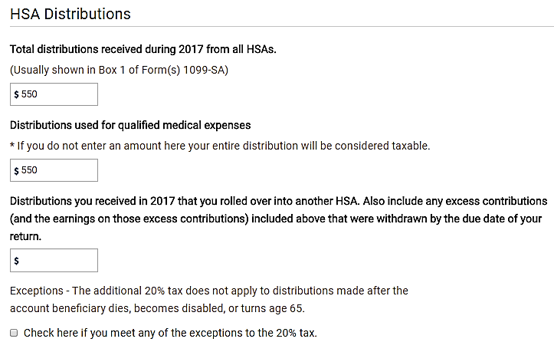
TaxSlayer Form 8889 Distributions
NTTC-Modified Pub 4012 Tab E
Notes:
1099-SA reports HSA distributions.
Advise taxpayer to retain records of qualified medical expense receipts to support the HSA deduction with the tax return for the life of the return.

Slide 44
HSA Out of Scope
Excess contributions to HSA not withdrawn in timely fashion
Qualified HSA funding distributions from an IRA
Death of an HSA holder when surviving spouse is not the beneficiary

Slide 45
HSA Out of Scope
Archer Medical Saving Accounts (MSA)
Medicare Advantage MSA
Health Reimbursement Arrangement
Form 8889, Part III

Slide 46
HSA Quality Review
Confirm taxpayer has HDHP
Confirm contributions made or will be made by due date of return
Confirm distributions offset by qualified medical expenses and expenses not deducted on Schedule A
Verify Form 8889 and Form 1040 results

Slide 47
Health Savings Accounts

